Slide 1


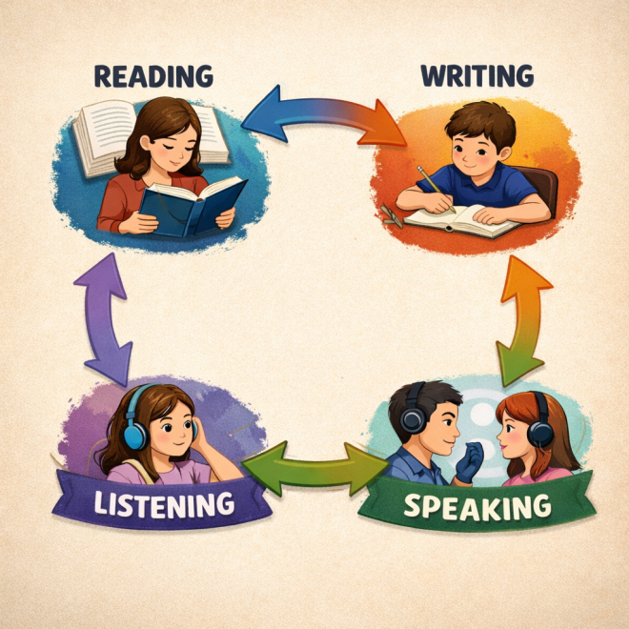



EFL Teaching Methodology
Fabian Wiese
Teaching the four main skills in
English as a Foreign Language (EFL)
Anhelina Romaniuk, Ukraine Yulia Rotar, Ukraine Ivan Luchynskyi, Ukraine Oleksandr Rabtsun, Ukraine Elssa Saba, Lebanon Sina Kouly, Lebanon Fabian Wiese, Germany

Slide 2

Purpose and scope of our project
Fabian Wiese
We are all passionate about teaching English as a Foreign Language (EFL)
Our aim: Create informative and helpful material for EFL teachers
Problem: It’s too much (there are thousands of books about EFL teaching and learning!)
→ We narrowed it down

Slide 3
Purpose and scope of our project
Fabian Wiese
Our scope: Create material concerning the “Four Main Skills”: speaking, writing, listening and reading
Goal: Create handouts for each skill with must-know information, things to look out for and exercises teachers can use to strengthen that specific skill.

Slide 4
State of our group
Fabian Wiese
Big lack of interaction and communication ❌
Many group members have not responded or contributed in any way since October or November (even after I texted them privately/outside of the WhatsApp group chat)
No responses → even to messages like “Please tell me if you are still taking part in the project” → even though they actually read the message in the group chat (!)
No attendance at weekly seminar sessions → never spoke with most of my group members
→ No judgement if people are facing hard times❗However: This makes it hard to move on as a group (should we wait for others or not?) 😟
Takeaway: If you are going through hard times, letting group members know that they should move on without you for some time is more helpful than ghosting. No justification needed, just a quick note. We’ve all been there. ❤️

Slide 5
Accomplishments
Fabian Wiese
Created a WhatsApp group together 💬
Agreed on an idea and distributed workload 💡
Managed to create an eTwinning project + TwinSpace 🛠️
Filled some TwinSpace pages with content 📝

Slide 6
Three things we could have done better
Fabian Wiese
Communication ❗
Most of us were never successfully approved for eTwinning (or at least did not join our project/TwinSpace) ❌
Things that were meant to be done collaboratively (e.g. group reports and group posts) were often done by only one or two group members due to a lack of interaction 😕

Slide 7
Three things that we did well
Fabian Wiese
We quickly agreed on a common interest and goal 🤝🏻
Creating the eTwinning project + TwinSpace went quite well 🏃‍♀️
Some of us did the TwinSpace page they were responsible for, so we gathered quite a bit of content regarding the four main skills. 📚

Slide 8
Reading + Writing and current state of our project
Ivan
Luchynskyi
Within the project, teaching materials aimed at the integrated development of reading and writing skills in learning English have been developed and analyzed. The project work is based on the communicative approach and considers reading and writing as interrelated types of speech activity.
The main focus is placed on working with texts of various genres, which serve as a source of language material for further written production. Reading is used to develop lexical and grammatical competence as well as skills of understanding the main idea and detailed information, while writing ensures consolidation and active use of the acquired material in students’ own written output.
At the current stage of the project, a system of tasks combining text analysis with written responses, information summarizing, short written statements, and creative activities has been developed. The results obtained confirm the effectiveness of the integrated approach, which increases learners’ motivation and promotes more conscious and confident use of the English language.

Slide 9
Listening + Speaking and questions/discussion
Ivan
Luchynskyi
Within the project, listening and speaking skills are addressed as interconnected components of communicative competence in English. Listening is used to provide authentic language input, develop comprehension of spoken texts, and consolidate vocabulary, grammar, and pronunciation. Speaking allows learners to actively use this input, produce coherent utterances, participate in dialogues, and express personal opinions.
A special focus of the project is on interactive tasks, including questions and discussions. These activities encourage students to respond to spoken prompts, ask questions, clarify meaning, and engage in collaborative communication. Such tasks not only reinforce comprehension and oral production but also develop critical thinking and the ability to participate in real communicative situations.
At the current stage, the project includes structured exercises where students listen to audio texts, answer questions, discuss content with peers, and perform role-plays or mini-presentations. Results indicate that integrating listening with speaking and interactive discussion promotes higher motivation, deeper understanding, and more confident language use.

